Slide 1


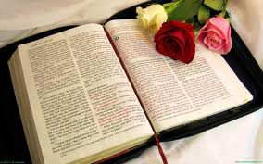

Slide 2
Teacher’s Introduction
Md. Mainul Hoque
Asst. Teacher(English)
Foylahat Kamal Uddin High school,
Rampal,Bagerhat.
Contact No. 01711-281317
mainulmilon@gmail.com

Slide 3
Subject Introduction
English For Today
Class : Ten
Unit : 14
Lesson : 2 Time: 45 Minutes.
The Shat Gambuj Mosque

Slide 4
Learning Outcomes
By the end of the lesson:
* The students will be able to tell about Khan Jahan Ali.
* The students will be able to tell about the historical background of the mosque,
* The students will be able to describe the domes,
* The students will be able to tell about what is Bagerhat famous for.

Slide 5
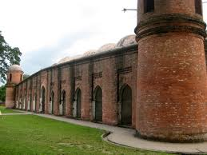
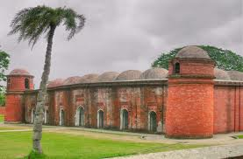
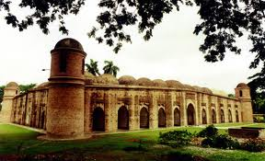
Look at the pictures below:
Can you tell me what can you see in these pictures?

Slide 6
THE SHAT GAMBUJ MOSQUE

Slide 7
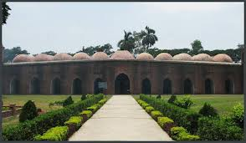
THE SHAT GAMBUJ MOSQUE

Slide 8
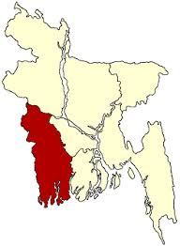
Bagerhat
THE SHAT GAMBUJ MOSQUE is situated in Bagerhat district.

Slide 9
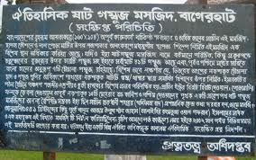
Read the board below

Slide 10
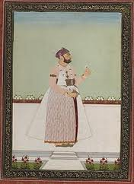
Saint Ulugh Khan Jahan Ali built the mosque in mid-15th Century.

Slide 11
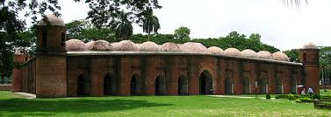
The mosque is roofed over with 77 squat domes.

Slide 12
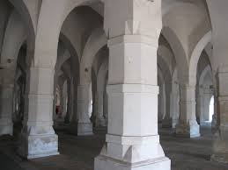
The arches are 6 feet in thickness

Slide 13
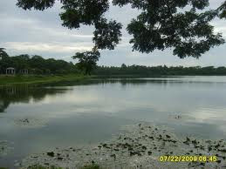
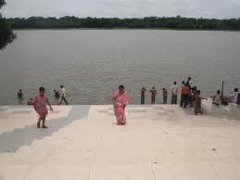
Khan jahan Ali dug many tanks.
The mosque stands on the eastern bank of a vast sweet water tank

Slide 15
Read the text
Sixty Dome Mosque in Bagerhat district of Bangladesh in the south - west of the ancient mosque. There is an inscription on the mosque . So it had been in the building at the time of construction or correct any information not available . However, it is seen that the Khan mosque architecture - e - do not have any doubt about the universe was created . The idea is to build it in the 15th century . For many years the mosque, and many were spending money to build . Stones were brought from rajamahala . It's located in one of three World Heritage sites ; Bagerhat saharatikei has been hailed as a World Heritage site . In 1983, UNESCO provided in this respect .
The mosque in north - south to the outer side and the inner side of the 143 feet long and 160 feet east - west side of the outer and inner side about 104 feet wide , about 88 feet . Approximately 8.5 feet thick walls .

Slide 16
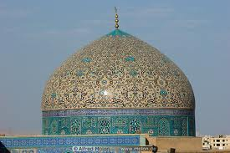
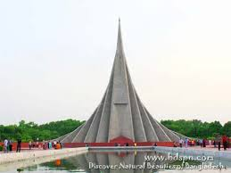
Vocabulary
1.Dome-
A round roof
2.Monument-
a statue, building, or other structure erected to commemorate a notable person or event:

Slide 17
Pair work
Make a dialogue between you and your partner about The Shat Gambuj Mosque.

Slide 18
Group Work
Discuss in your group and make 5 sentences about The Shat Gambuj Mosque

Slide 19
Evaluation
1.Who built the mosque?
2. How many domes are there in that mosque ?
3. Where is the mosque situated ?

Slide 20
HOME WORK
Write a paragraph in your own words about The Shat Gambuj Mosque.

Slide 21

THANK YOU

